Slide 1

Low-Cost AI-Based Semiconductor Defect Detection System Using Computer Vision
Final Year B.Tech Capstone Project Proposal
Guide: Dr. Subhasish Mahapatra
Student: [Sujal Kumar (23BEC7061) Dania Firdoush(23BEC7084) ] Department: Electronics & Communication Engineering SENSE
Academic Year: 2023–27
COMPUTER VISION
DEEP LEARNING

Slide 2
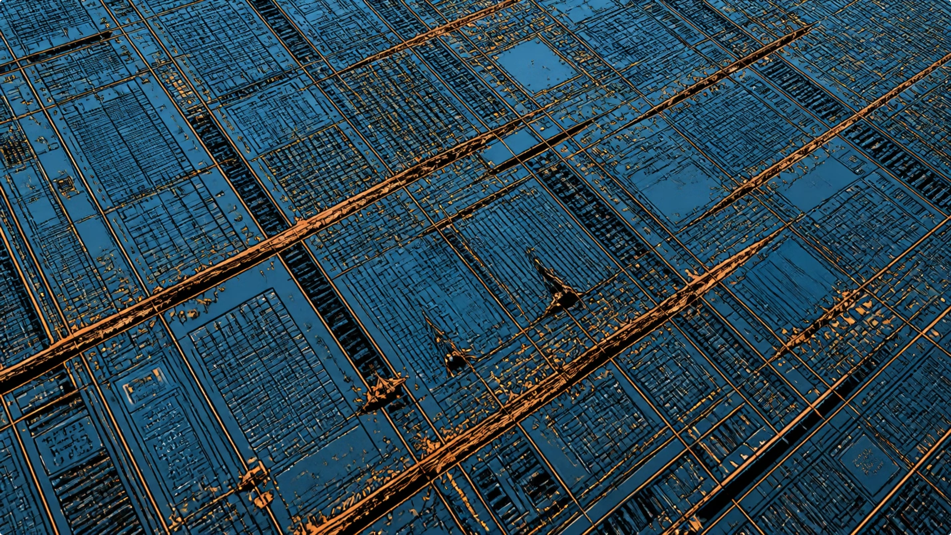
Problem Statement & Motivation
The Inspection Challenge
Semiconductor fabs require 100% wafer inspection — even microscopic defects cause chip failure
Manual inspection is slow, costly, and error-prone under high-volume production
Industrial AOI systems cost $50K–$500K, inaccessible to SMEs and research labs
Core Gap: No affordable, automated, AI-driven inspection solution exists for low-resource environments.

Slide 3

Proposed Solution: AI-Based Defect Detection System
An end-to-end automated pipeline combining CNN-based classification with a web monitoring dashboard — deployed on existing hardware at near-zero cost.
Wafer Input
CNN Preprocess
Defect Classify
Web Dashboard
The system accepts wafer map images or live camera input, processes them through a trained CNN, and outputs defect type, confidence score, and severity rating via a browser-based interface.

Slide 4
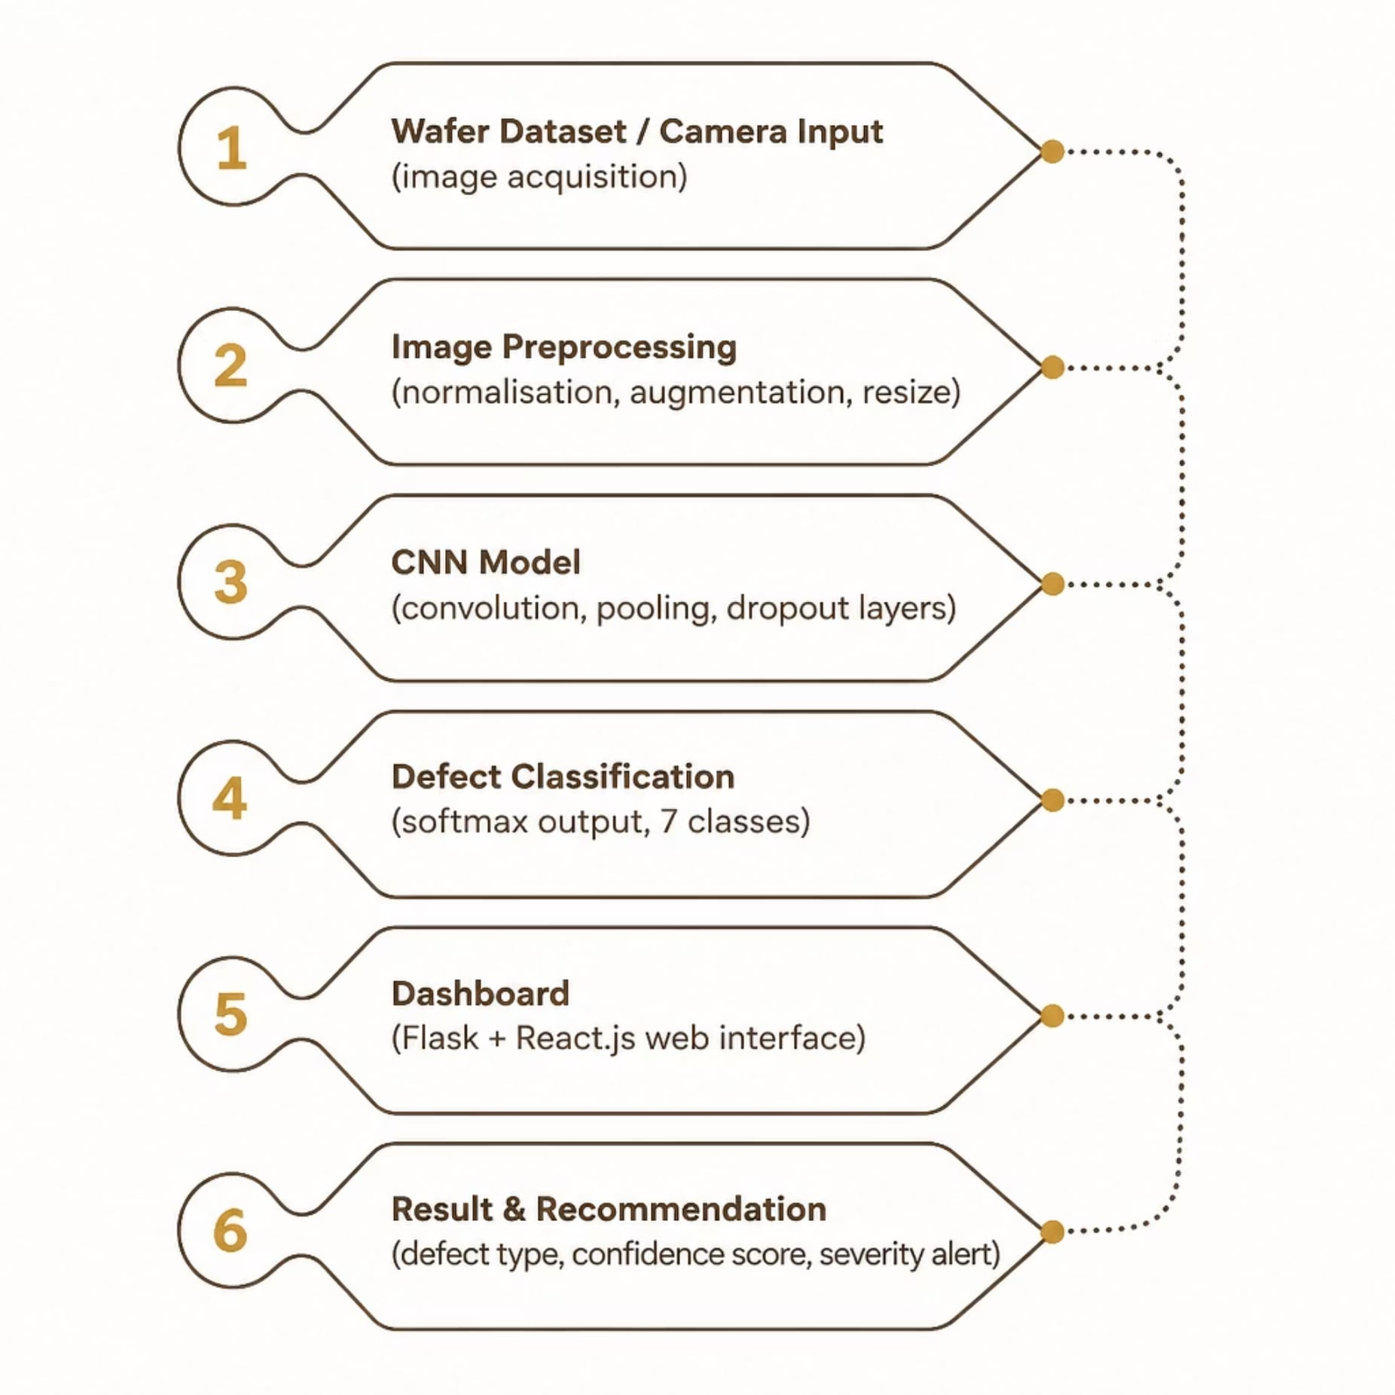
System Architecture
Architecture Highlights
Input Layer: WM811K dataset or USB camera feed (256×256 grayscale)
Preprocessing: Normalisation, data augmentation, noise filtering via OpenCV
CNN Core: 4 convolutional blocks with max-pooling and dropout regularisation
Output: 7-class softmax with confidence thresholding and severity flagging

Slide 5
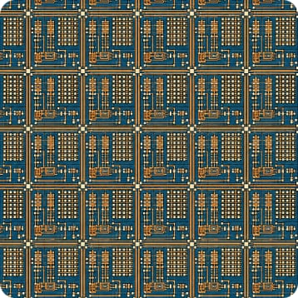
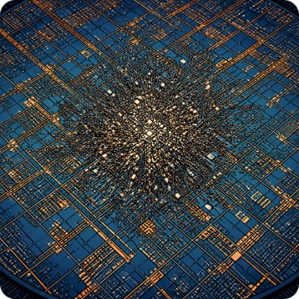
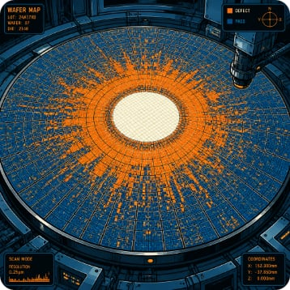
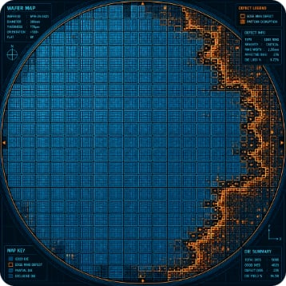
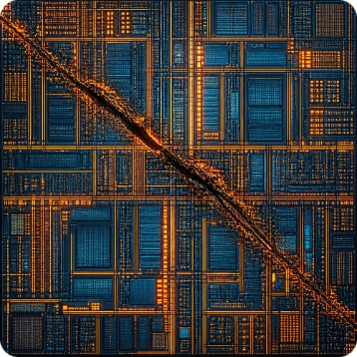
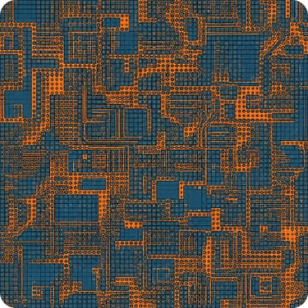
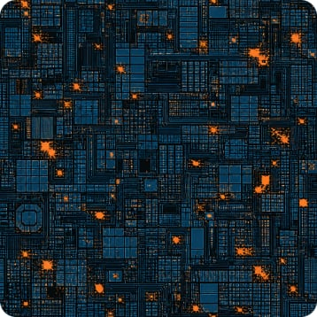
Dataset & Defect Categories
The WM811K Wafer Map Dataset (Kaggle) contains 811,457 labelled wafer maps across 7 defect patterns — the benchmark for semiconductor ML research.
Normal
Center
Donut
Edge Ring
No defects detected
Defects clustered at wafer center
Ring-shaped defect distribution
Defects along wafer perimeter
Scratch
Near Full
Random
Linear mechanical damage marks
Near-total wafer coverage
Scattered, uncorrelated defects

Slide 6
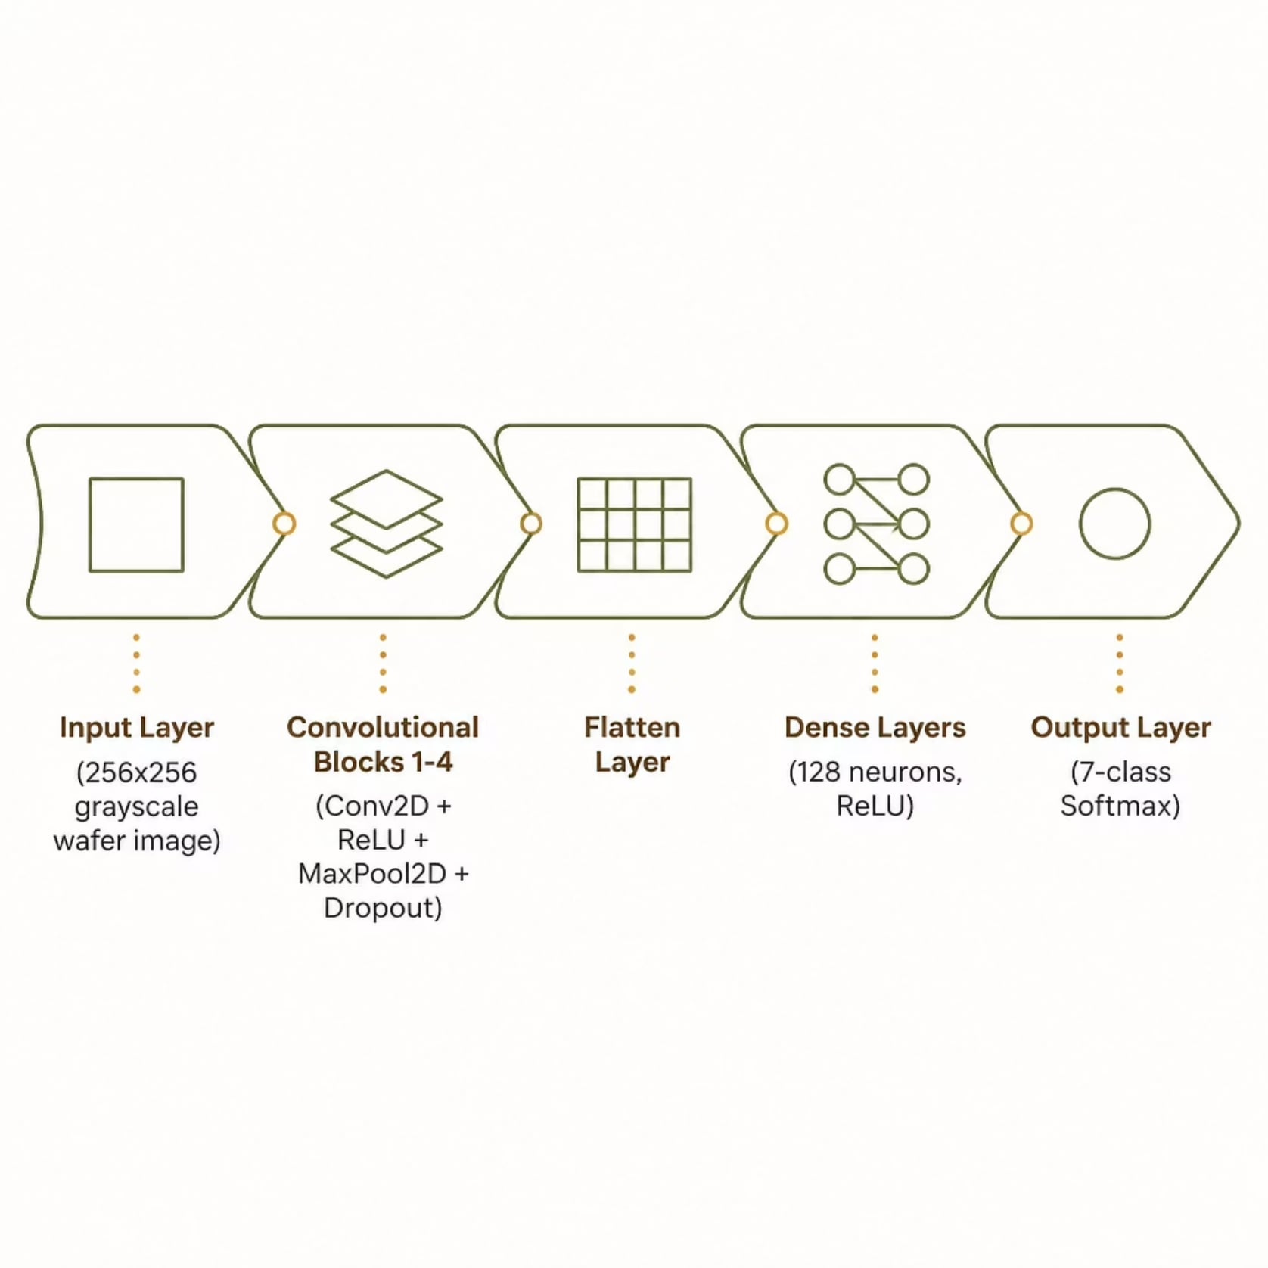

AI Model Design: CNN Architecture
Model Specifications
Input: 256×256 grayscale wafer map images
Feature Extraction: 4× Conv2D blocks (32→64→128→256 filters)
Regularisation: MaxPooling2D + Dropout (0.5)
Classification: Dense(128, ReLU) → Softmax(7)
Tools: Python 3.10, TensorFlow 2.x, Keras, OpenCV
Target accuracy: >95% on WM811K test set

Slide 7

Software & Hardware Requirements
Software Stack
Hardware
Tool
Purpose
Component
Specification
Python 3.10
Core language
Laptop (existing)
Intel i5 / 8 GB RAM
TensorFlow 2.x
CNN model training
Storage
SSD (dataset ~2 GB)
OpenCV
Image preprocessing
USB Camera (opt.)
5 MP, ₹800–₹1,000
Flask
REST API backend
Internet
For dataset & libraries
React.js
Web dashboard UI
All software is open-source and free. No dedicated GPU required.

Slide 8


Cost Analysis & Feasibility
Budget Breakdown
Feasibility Assessment
Item
Cost (₹)
✅ Technically Feasible
Existing Laptop
₹0
Proven CNN architectures on public dataset; open-source toolchain
WM811K Dataset
Free
Software Tools
Free
✅ Financially Feasible
USB Camera (optional)
₹800–₹1,000
Near-zero capital expenditure; leverages existing institutional hardware
Total Estimated
₹0–₹1,000
✅ Academically Suitable
Integrates ECE, AI, and embedded systems — ideal for final-year scope

Slide 9




Expected Results & Industry Applications
System Outputs
Industry Relevance
Directly applicable to semiconductor manufacturers seeking cost-effective inline inspection:
Defect Type
Confidence Score
One of 7 WM811K classes
Softmax probability (%)
Severity Flag
Pass / Monitor / Reject
Target classification accuracy: >95% on held-out test data
Intel · AMD · NVIDIA
Qualcomm · Micron
Semiconductor Fabs
High-volume fab defect screening
Mobile & memory device QA
SME and research lab deployment

Slide 10
Conclusion & Future Scope
Project Summary
Future Roadmap
Low-cost, AI-driven wafer inspection system — under ₹1,000
Converges ECE, Computer Vision, Deep Learning, and Industry 4.0
Deployable on existing hardware with open-source tools only
Addresses a real industrial gap in affordable automated inspection
01
Real-Time Camera Inspection
Live wafer feed with sub-second inference
CAPSTONE-READY
IEEE-ALIGNED
02
Raspberry Pi Edge Deployment
Portable, low-power inline inspection unit
03
FPGA Acceleration
Hardware-level inference speed-up for production fabs
04
Industrial-Scale Pilot
Collaboration with semiconductor manufacturing partners

